Slide 1
EECS-731 Understanding climate change with data-science
Team Oracle
Austin Adams
Pushkar Singh Negi
Ravali Kondreddi
Ronald Moore
Waqar Ali

Slide 2
Introduction
What is this project about?
What is climate-change?
Make hypothesis about factors which cause climate-change
Consumption of fossil-fuels
Emission of CO₂
Population increase
Melting of polar ice-caps
Emission of Ozone depleting substances

Slide 3
Introduction
Role of Data-Science
Identify if we can correlate the trends in the identified factors over the years with climate-change trend
Use classification / clustering techniques to make predictions
Explore the occurrence of natural disasters in the last century
Correlate with climate change trend
Use time-series forecasting to predict future disaster trend

Slide 4
“ Climate change is a change in the statistical distribution of weather patterns when that change lasts for an extended period of time .”
Wikipedia

Slide 5
Data Exploration

Slide 6
Global Temperature
Features
Timestamp
Average Land Temperature (TempLand)
Uncertainty in Average Land Temperature
Max Land Temperature
Uncertainty in Max Land Temperature
Average Land and Sea Temperature (TempGlobal)
Uncertainty in Average Land and Sea Temperature

Slide 7
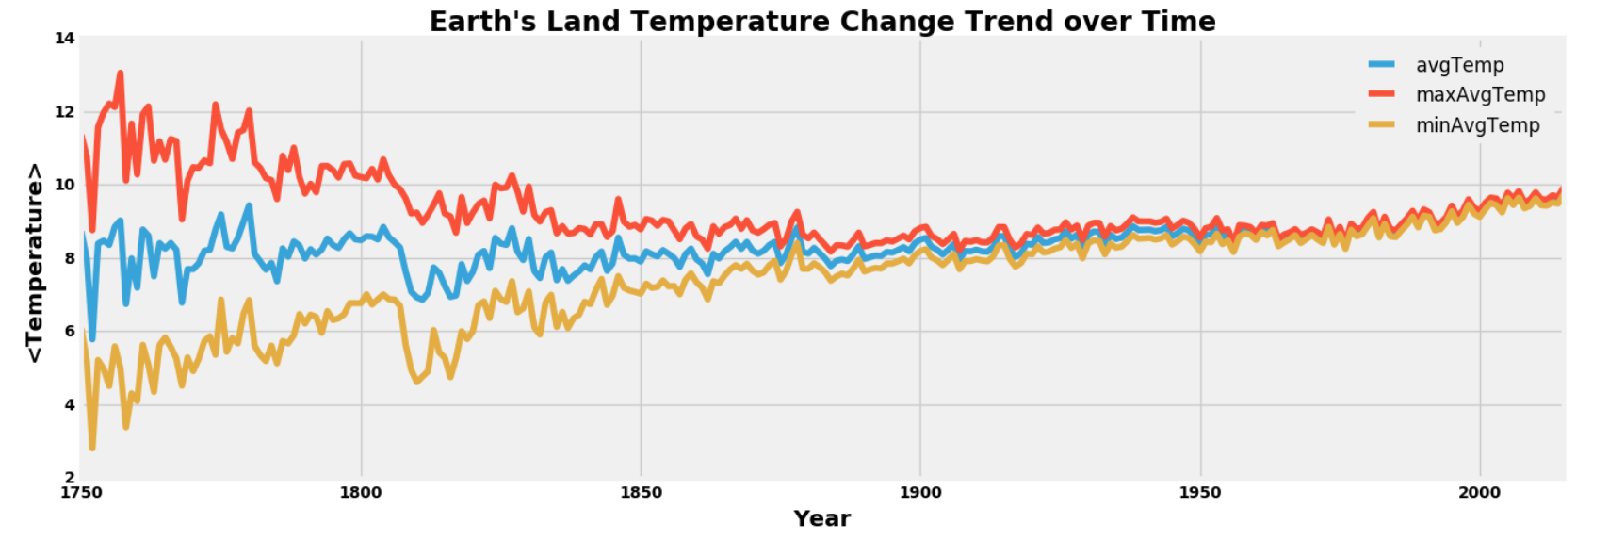
Global Temperature
Annual Trend

Slide 8
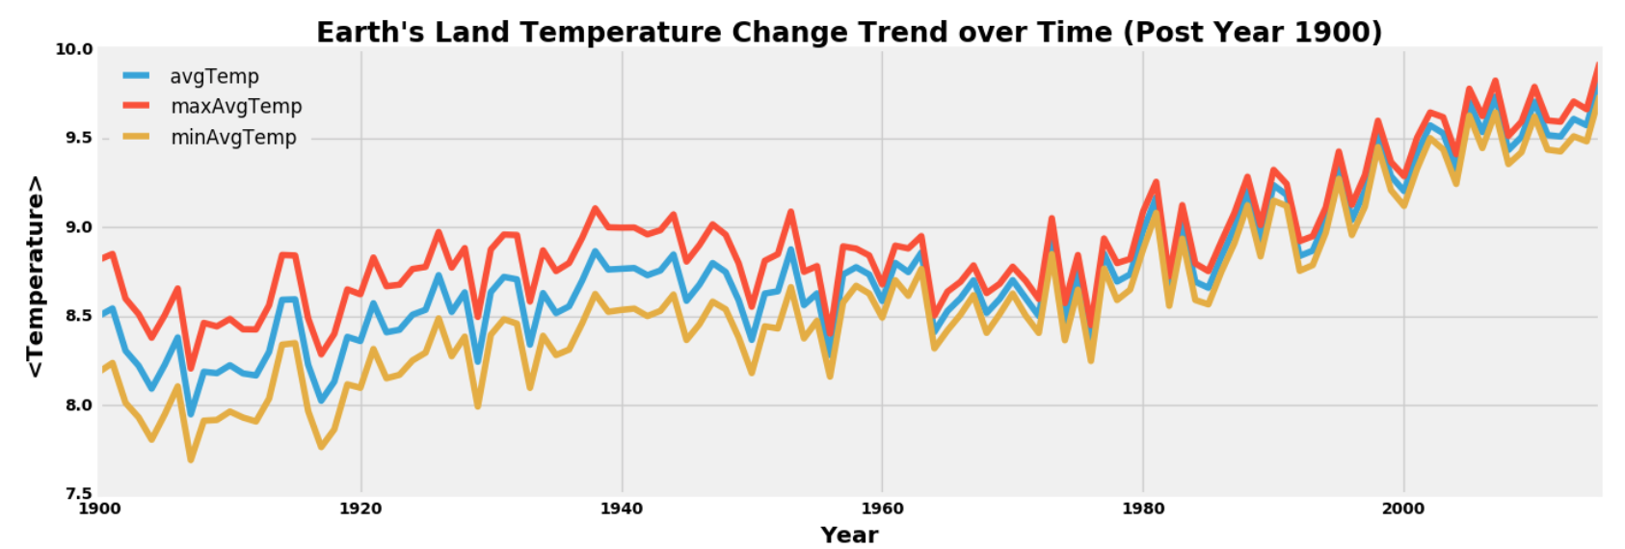
Global Temperature
Annual Trend (Last Century)

Slide 9
CO₂ Emission
Features
Year
Entity (Country Name)
Code (Country Code)
Annual CO₂ Emission (Million Tonnes)
Strategy
Aggregate values on a per-year basis across all entities

Slide 10
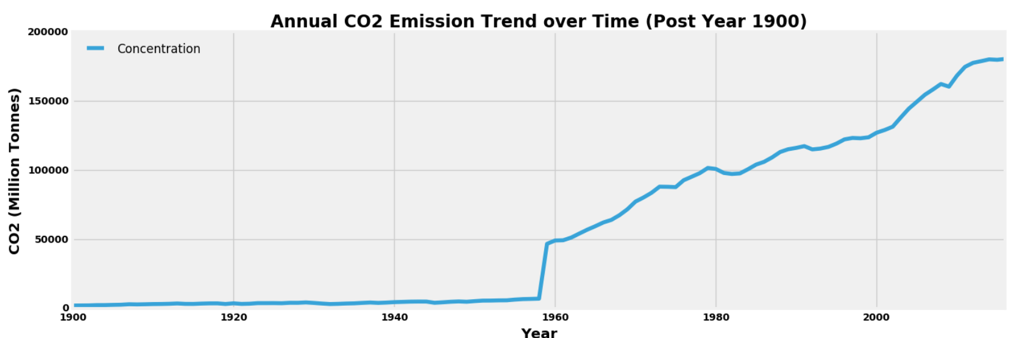
CO₂ Emission
Annual Trend (Last Century)

Slide 11
OIL
Features
Year
Annual consumption (measured in terawatt-hours)

Slide 12
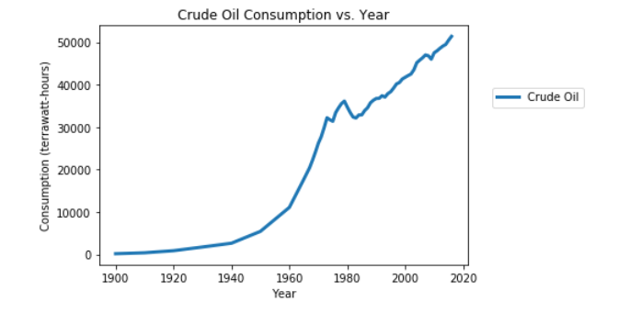
oil
Annual Trend(Last Century)

Slide 13
coal
Features
Year
Annual consumption (measured in terawatt-hours)

Slide 14
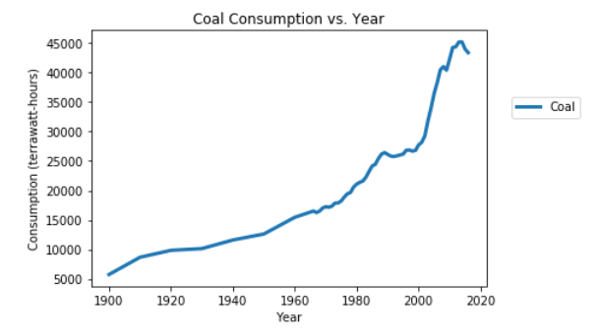
coal
Annual Trend(Last Century)

Slide 15
GAS
Features
Year
Annual consumption (measured in terawatt-hours)

Slide 16
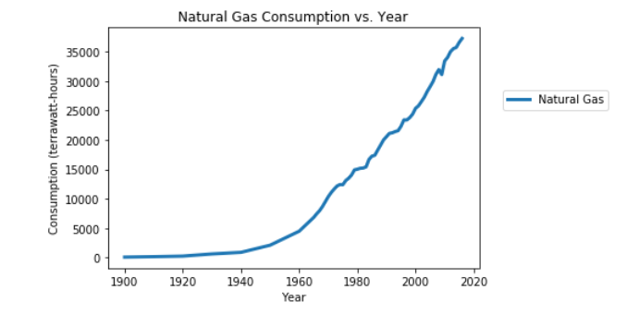
GAS
Annual Trend(Last Century)

Slide 17
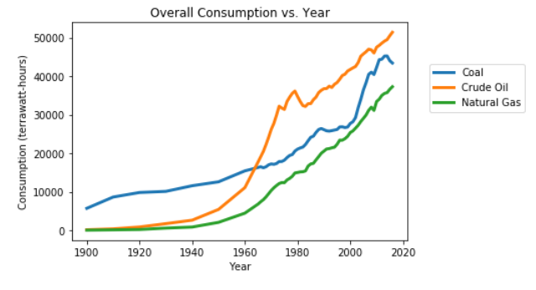
Fossil fuels
Annual Trend(Last Century)

Slide 18
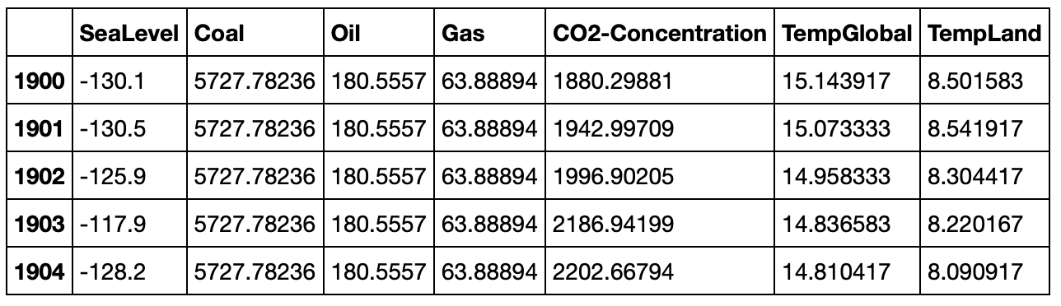
Merged dataset
Features
Notes:
Replace this snapshot

Slide 19
Clustering

Slide 20
Template
Subtext
Body/bullet text with no bullet icon

Slide 21
ClAssification

Slide 22
Purpose
Try different features to accurately predict the class of the temperature
Observe which features are contributing the most to the increase in temperature

Slide 23
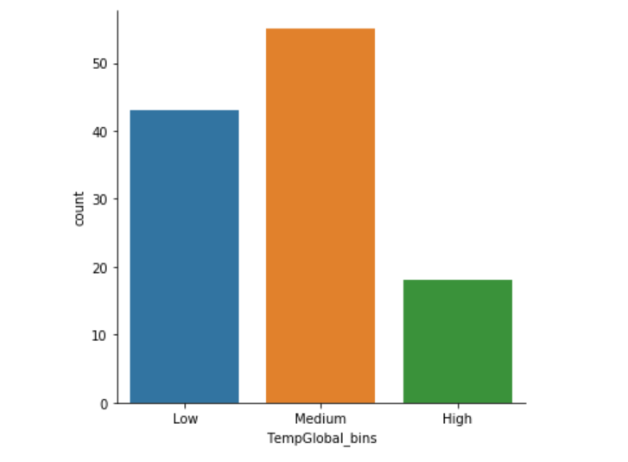
PROCESS
Range of temperature values very small
Temperature values placed into 3 separate bins (low, medium, high)

Slide 24
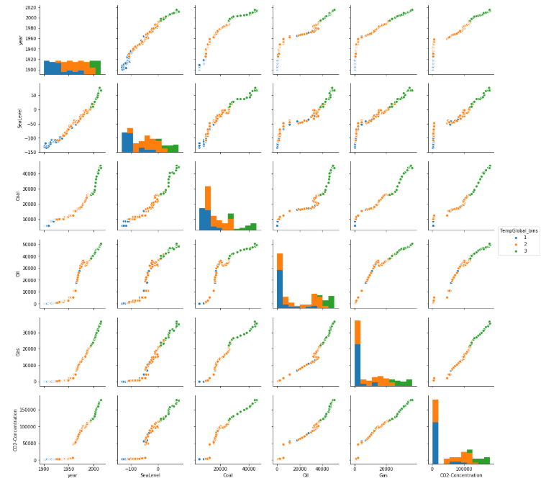
PROCESS (Continued)
Use a pair plot to determine which features provide the best separation of bins
Arbitrarily choose two features for training and testing different classification models (chose coal, gas)

Slide 25
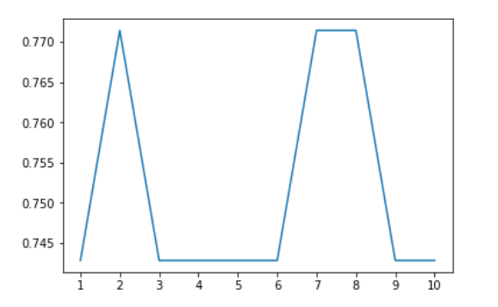
MoDELING
Accuracy of KNN Models Using Different Values of N
Accuracy on x-axis, Value of N on y-axis

Slide 26
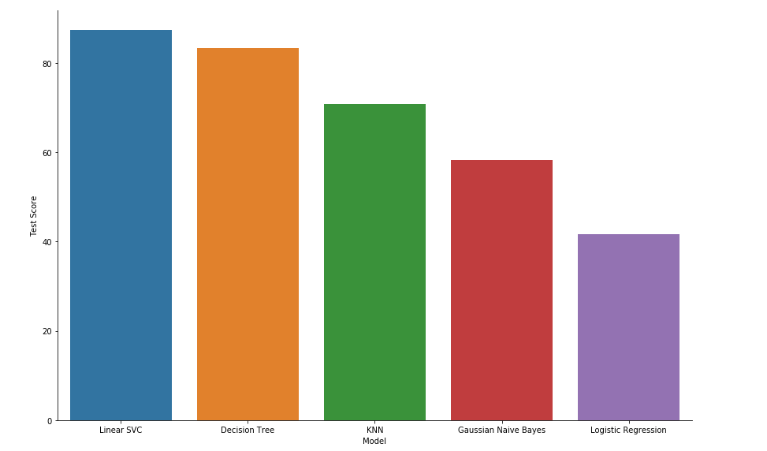
MoDELING
Different models tried and tested (SVM, Logistic Regression, KNN, etc.)

Slide 27
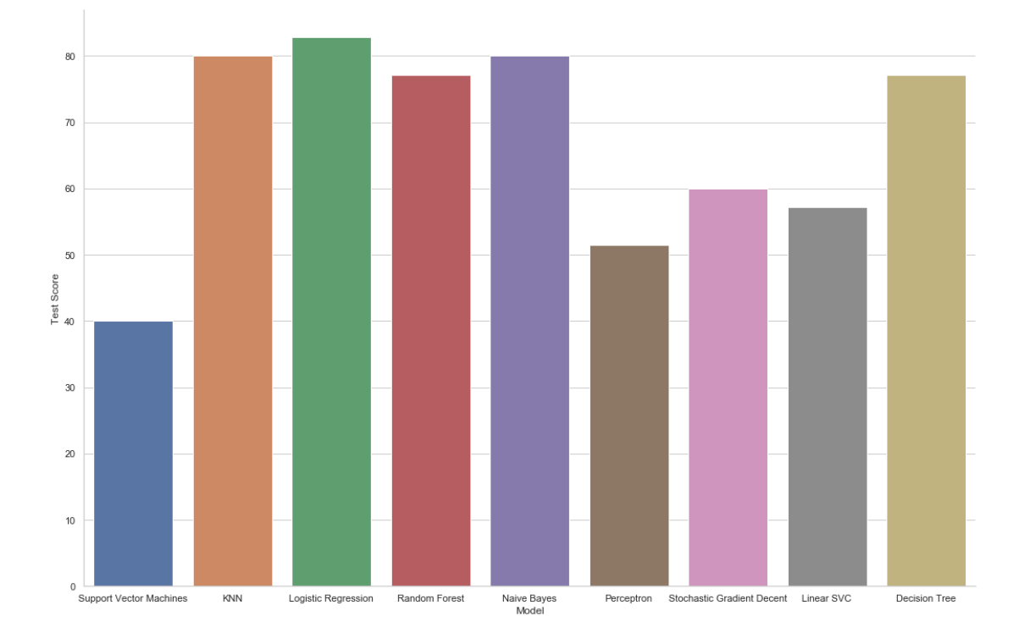
PROCESS (Continued)
Classification Using All Features

Slide 28
Anomaly Detection

Slide 29
Template
Subtext
Body/bullet text with no bullet icon

Slide 30
Statistical Analysis

Slide 31
Template
Subtext
Body/bullet text with no bullet icon

Slide 32
Natural Disasters

Slide 33
Template
Subtext
Body/bullet text with no bullet icon

Slide 34
ConClusion

Slide 35
Learning outcomes
EECS-731
Body/bullet text with no bullet icon

Slide 36
Questions?

Slide 37
Multi-image layout 4up
Title with images
Title Goes Here
Supporting text here
Title Goes Here
Supporting text here
Title Goes Here
Supporting text here
Title Goes Here
Supporting text here

Slide 38

title
Subtitle
Text goes here
Text goes here
Text goes here
Text goes here

Slide 39
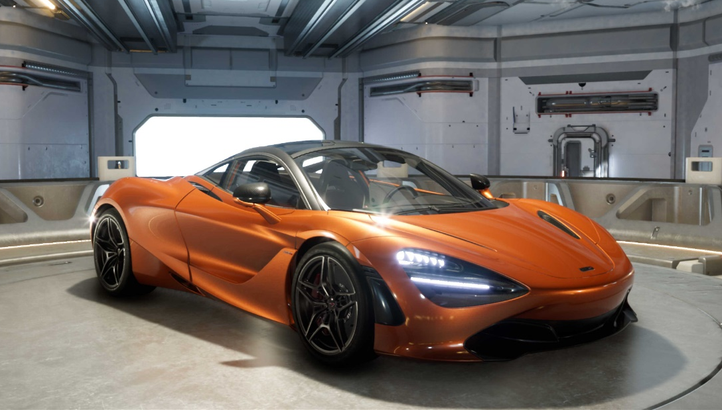
Imagery, chart and text
Subtitle
Use body text sparingly on slide types that include other information, such as, an image and data/chart. Too much on the slide might be hard for the viewer to take in.

Slide 40
“ Quoted text example goes here. Trebuchet, 42 pt. Use with shorter (headline type) quotes.”
Quote Source, Trebuchet 16 pt

Slide 41
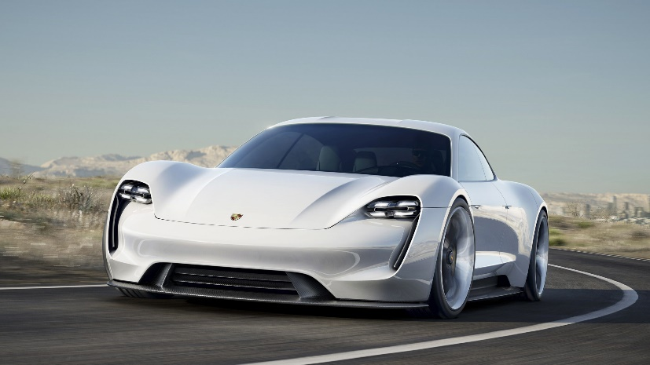
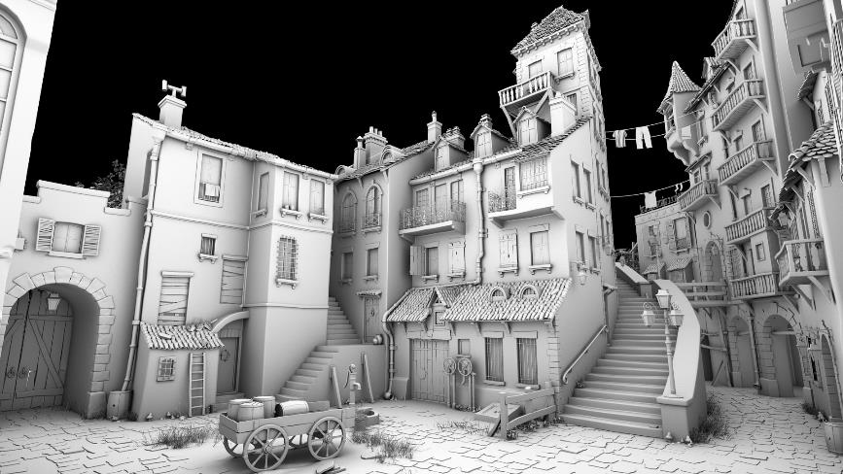


Timeline with images
Text Goes Here
Text Goes Here
Text Goes Here
Text Goes Here
xxxx
xxxx
xxxx
xxxx
Source: Source information is 8 pt, italic

Slide 42
World map
<Explanation>
Helsinki
Santa Clara
Tokyo

